Slide 1





Secure, Unified Logging and Monitoring for Offsite Environments
Enterprise strategy for Wholesale Credit and LendingCentralized visibility, early anomaly detection, auditability, and cross-environment standards for DCP, GCP, and legacy on-prem.
Skandan
AI/ML Engineer

Slide 2







Strategic Objectives for Application Logging and Monitoring
Why these goals matter for Wholesale Credit and Lending operations
Centralized visibility
Early anomaly detection
Risk and audit compliance
Reduces mean time to detect across distributed stacks; assign owners and map flows
Enables faster containment and fewer loan-processing errors; align alerting and tooling
Ensures traceability for credit decisions and regulatory checks; define retention and encryption policies
Standardization across DCP, GCP, and legacy
Offsite readiness
Common implementation priorities
Reduces incident friction and onboarding time; standardize schemas and tooling integrations
Maintains availability during failover and audits; replicate logs offsite with encryption
Define ownership, map data flows, align retention and encryption policies

Slide 3
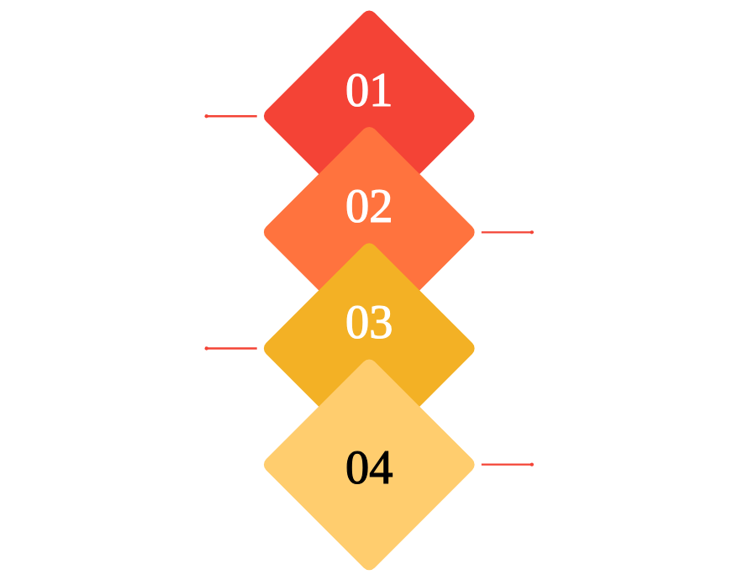
Architecture Blueprint for Logging and Monitoring
Layered strategy for reliable logs, analytics, and observability
Application Logging Layer
Standardize JSON logs with required fields and correlation IDs; mask sensitive fields at source.
Log Transport Layer
Environment-specific mappings and encrypted pipelines to deliver logs to storage reliably.
Log Storage and Analytics
SIEM and BigQuery with hot and cold tiers plus offsite archiving for cost and query performance.
Monitoring and Observability Layer
OpenTelemetry metrics and traces feeding dashboards and alerting rules for SRE, risk, and audit needs.

Slide 4





Standards and Governance Model for Logging and Monitoring
Preserve JSON logs, enforce schema, align SRE SLIs/SLOs and ownership
01
02
03
04
05
Governance Practices and Runbooks
Logging Standards
Monitoring Standards
SRE SLIs and SLOs
Responsibility Matrix
Use JSON logging format for all services
Define severity guidelines mapped to alert tiers
Availability SLO: 99.9%
Enforced schema validation at ingestion
Dev: implement logging schema and error codes
P95 latency target: under 200ms
Include mandatory correlation IDs in every record
CI/CD linting gates for log schema and metrics
SRE: define SLIs/SLOs, runbooks, monitoring KPIs
Track Monitoring KPIs and SRE SLIs continuously
Error rate SLO: under 0.1%
Runbooks aligned to alerting tiers with playbooks
Standardize error codes: AUTH-1000, DB-3000, API-4000, etc
Throughput ranges documented per service
Security: PII controls, access and retention policies
CI/CD linting for log schema before deployment
Periodic governance audits and remediation tracking
Exclude all PII from logs; adhere to data retention policy
Audit: periodic reviews and compliance reporting
Periodic audits of log quality and access controls

Slide 5











GCP Logging and Monitoring Strategy
Design controls for reliable, cost‑effective log delivery and governance
GKE / Cloud Run / Compute Engine
Cloud Logging
Log Router
Pub/Sub
Consumers: SIEM / BigQuery / Storage
Central log collection, retention, and basic transforms
Filter and route logs; reduce noise and cost before export
Reliable transport with subscriptions and dead letter queues for delivery guarantees
Applications and platform components emit logs and metrics to Cloud Logging and Prometheus for custom metrics
Splunk or Elastic for security, BigQuery for analytics with enforced schema, Cloud Storage for archives

Slide 6
Offsite Consumption Strategy for Application Logging
Replicate logs to separate storage with secure, immutable analytics access
Primary Logging
DR Dashboards and Synthetic Checks
Collect logs from DCP, GCP, and on-prem apps with standard schema and metadata
Run disaster recovery dashboards and synthetic checks from offsite environment
Replicate to Offsite Storage
Failover Contracts
Geographically separate storage with encryption and immutability enabled
Provider-agnostic ingestion contracts so consumers can failover to offsite endpoints
Offsite Archive and Analytics
Operational Validation
Archive plus SIEM/analytics pipelines for Splunk ITSI, Dynatrace, Datadog AI
Annual failover tests, data integrity validation, and access control parity
Read-only Endpoints
Provide read-only access endpoints for offsite SIEM and downstream consumers

